Slide 1

APA 7th Edn. Referencing

Slide 2
This session will help you to:
Understand why you need to reference.
Understand when to include in-text citations to sources in your text.
Learn how to use and apply the APA 7th referencing style to your work to create your citations and reference list.
Notes:
These are the learning objectives for the session. They are repeated on a slide at the end of the talk so that participants can complete the feedback survey.

Slide 3
What does ‘referencing’ mean?
Notes:
Discussion prompt

Slide 4
What does ‘referencing’ mean?
Referencing is a vital part of academic writing
It involves acknowledging the source for information or ideas you have used in your own work
We are also informing the reader of the sources we have used

Slide 5




What does ‘referencing’ mean?
Sources of information
Any place from which information can be taken (and which your reader could also access) can be called a ‘source’.
There are multiple ways of incorporating this information into assignments.
Source
Information
A quote from a book or article
Data taken from research
An image or a picture from a website

Slide 6
Why reference?
Notes:
Discussion prompt

Slide 7

Why do we need to reference?
Supports your arguments with evidence and examples
Gives others credit and recognition for their work, avoiding plagiarism
Separates your ideas from the ideas of others
Demonstrates the quality of resources you have used and your own knowledge of the subject
Notes:
Here is a list of some of the main reason we reference. You may also have come up with some extra ones.
Correct referencing also helps us to avoid plagiarism (this is coming up in a couple of slides)
Might also point out that there are often marks awarded in assignment assessments for proper referencing.

Slide 8

Academic Integrity
Includes plagiarism, collusion and improper use of generative AI tools.
Academic Integrity breaches are sometimes deliberate, but often they are caused by poor referencing practice!
Failing to make it clear when you’re quoting
Giving inaccurate information about a source
Not indicating which sources you have used
Notes:
Plagiarism is sometimes done deliberately, but often plagiarism comes about through poor referencing, either failing to understand when you need to provide a reference or providing a reference that is inaccurate or incomplete. Either way, it is something definitely to be avoided and can result in reduced grades for work or having to resubmit assignments.
Duck – Mentimeter on ac int (https://www.mentimeter.com/app/presentation/albib75tjhctv9j24x6s7kwfnngakpt7/edit?question=5chve9rpm8ep)

Slide 9
When do we need to reference?
Notes:
Discussion prompt
Deciding when we need to include a reference is really important. It is up to us to understand when it is appropriate to include a reference to one of our sources.

Slide 10

APA 7th edn. style
CU Group uses the APA (7th edn) referencing style.
The style tells us exactly which details about a source we must use and how they should be presented
You’ll need to use this referencing style in your assessed work
Help is available on our LibGuides pages
Notes:
A referencing style gives you a standard and consistent way to describe each of your sources. This helps ensure that you include all the key information and don’t miss anything. It also makes it much easier for anybody reading your work to check your references and find any of the sources you’ve used for themselves.

Slide 11

What do you need to include?
In text citation
Reference to the work used in the body of your writing.
Reference List
List of all the sources you have cited in the body of your writing.

Slide 12

In-text citations
Used whenever you quote, paraphrase, summarise, include data etc.
Give the author’s surname, year of publication, and page number (if there is one and it is relevant to do so).
Notes:
We use a citation whenever we quote, paraphrase, summarise, use data or idea etc. From one of our sources.

Slide 13
In-text citations: information-prominent
(Give the author’s surname, year of publication, and page number (if there is one and it is relevant to do so).
Students typically write multiple drafts before submitting their assignment (Cottrell, 2013, p. 297).
Whilst the pass rate for driving tests is currently 44.7% (DVSA, 2023), there is still stigma attached to multiple failures, particularly for younger learner drivers (Evitts, 2022).
Notes:
Standard format

Slide 14
In-text citations: author-prominent
(Give the author’s surname, year of publication, and page number (if there is one and it is relevant to do so).
Cottrell (2013) claims that “critical thinking when reading is essential to academic success” (p. 189).
DVSA (2023) data shows that fewer that 50% of tests are passed; however, Evitts (2022) claims that younger learner drivers in particular face stigma when they fail.
Notes:
Alt format – for variation and to verb-adjust reliability of information

Slide 15
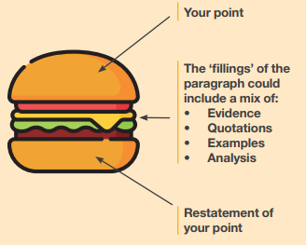
Example Paragraph
Whilst all major videogame companies utilize legacy IP, Nintendo is perhaps the most reliant upon it. 35% of first-party games released for the Switch console have utilised characters from older games (GamesRadar, 2022), many of these (including Mario, Zelda and Samus) dating back to the 1980s. Whilst several prominent critics (MacDonald, 2023; Brooker, 2020) argue that this holds back innovation in the marketplace, Nintendo’s decision to revisit legacy characters seems rooted in market research: a majority of consumers place IP familiarity above other metrics when choosing new purchases (Mintel, 2021a). This represents a challenge for third-party publishers with no roster of recognisable characters to draw upon, and may be a reason for the proliferation of ‘noun-like’ tags (‘Roguelike’, ‘Soulslike’, ‘MetroidVania’ etc.) used in marketing and promotion of new games which employ somewhat familiar mechanics; these are particularly evident in the promotional copy for PC gaming, which is an oversaturated market compared to console gaming (Mintel, 2021b). Whilst legacy IP’s presence in the marketplace represents a significant challenge when launching a new product, with careful marketing (and scheduling to avoid ‘big beasts’ such as Breath of the Wild 2 (Diamond, 2023)) a new game can gain market penetration.

Slide 16

Reference Lists
At the end of your assignment
Full details of the sources you have used
Should match in-text citations
Alphabetical by author
One long list of everything: no need to separate books, websites, journals etc. (unless your lecturer tells you otherwise)
Notes:
The second thing we need to include is the reference list. Every citation should match something in the reference list.

Slide 17
APA Layout (General Rules)
Who wrote it. (When they wrote it). What it’s called. How you’d find it.
Achebe, C. (2001). Things fall apart. Penguin.

Slide 18
APA Layout (General Rules)
Who wrote it. (When they wrote it). What it’s called. How you’d find it.
Achebe, C. (2001). Things fall apart. Penguin.

Slide 19
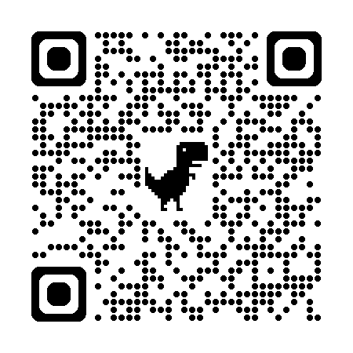
Referencing LibGuide
Our APA LibGuide gives information about how to reference every type of information you are likely to use for assignments.
We suggest it’s worth a bookmark!
https://libguides.coventry.ac.uk/cugapa

Slide 20
Reference Generators
You can use a reference generator (refgen) to help you produce APA references.
It is important to check the quality of the reference it gives you. Refgen sites often miss authors off for websites, for example.
LLR recommend:
mybib for a reliable reference generator
Zotero for reference management.

Slide 21
Books
Author, N. (Year). Title (Edition.). Publisher.
Butler, G., & McManus, F. (1998). Psychology: a very short introduction. Oxford University Press.
Notes:
A hanging indent has appeared. It’s super-effective.

Slide 22
Websites
Author, N. (Date). Title of the specific webpage. Website Name. www.website.com/page
Health and Care Professions Council. (2018). Standards of proficiency. https://www.hcpc-uk.org/standards/standards-of-proficiency/
Notes:
Named authors preferred to an organisation; reputable organisations can be considered authors.
APA Manual ch9.35: ‘links should be live if the work is to be published or read online’. Default (blue, underlined) links are acceptable within guidelines.

Slide 23
Missing Information?
No Date?
If you can’t find a year of publication, replace the date with n.d.
E.g. Smith (n.d.) claims that “beans means Heinz” (p. 45).
No Edition?
If you cannot find an edition, leave it out.
No author?
If there is no personal author is there a corporate author for the website?
Coventry University
NHS

Slide 24
Multiple Authors
1-2 authors: List all authors in both the in-text citations and reference list entry.
3 or more authors:
In-text citation: List first author, followed by ‘et al.’ e.g. (Torrington et al., 2017)
List of references: List all authors e.g. Torrington, D., Hall, L., Atkinson, C., & Taylor, S. (2017) Human reso…

Slide 25
Online Reports
Organisation. (Year). Title of report. Site name. www.website.co.uk/report
Fairbairn, C. (2020). Build back better. Confederation of British Industry. https://www.cbi.org.uk/ articles/build-back-better/
Notes:
This is functionally the same style as websites (you can give page numbers in citations though)

Slide 26
Articles
Author, N. (Year). Article title. Journal title, Volume (Issue), page range. DOI
Button, J. E., & Dutton, R. J. (2012). Cheese microbes. Current Biology, 22(15), R587-R589. https://doi.org/ 10.1016/j.cub.2012.06.014
Notes:
DOI is preferred to a web address, and should be included where possible if found online
Note the awkward formatting for some of these bits of information (run-on for journal title, volume in italics, title case vs sentence case)

Slide 27
Acts of Parliament
Title of the Act of Parliament (year is part of title)
Equality Act 2010
Notes:
Narrative citation within the text of assignment (ideally including the section number)

Slide 28
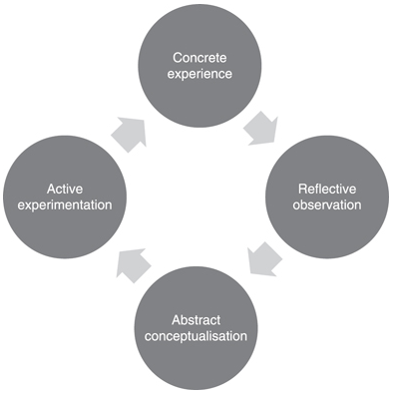
Images, Figures & Tables
Figure 1 Kolb’s cycle of experiential learning
(Atkinson, 2015, p. 42)
The source is included in reference list in its usual format
Notes:
Pure APA copyright attribution style is fiddly, designed more for publishing than assignments; this citation variant has been agreed for use at CU Group

Slide 29
Chapter in an Edited Collection
Author, N. (Year). Chapter title. In N. Editor (Ed.), Book title (pp. #-#). Publisher.
Barthes, R. (2004). Mythologies. In J. Rivkin & M. Ryan (Eds.), Literary theory: an anthology (2nd edn.) (pp. 81-89). Blackwell.
Notes:
Note that editor initials precede surnames for some reason

Slide 30
Multiple sources from the same year
The rollout was effective in the East Midlands (Dept. of Health, 2020a) but encountered more issues in the North East (Dept. of Health, 2020b).
The reference list will also include the letter coding with year of publication
Notes:
Typically the first citation should be (2020a), the second (2020b) etc. but the clarification is more important than the order

Slide 31
Secondary References
According to Bull (2002, as cited in Jones, 2010) international ‘society’ is “bound by a common set of rules […and] common institutions” (p. 112)
The reference list will only include Jones (only reference sources you have read)
Notes:
Page number refers to the text you read, not the text they quote

Slide 32
In this session we covered:
Why you need to reference.
When to include in-text citations to sources in your text.
How to use and apply the APA 7th edn. referencing style to your work to create your citations and reference list.
Notes:
These are the learning objectives for the session. They are repeated on a slide at the end of the talk so that participants can complete the feedback survey.

Slide 33
References
American Psychological Association. (2019). APA style. https://apastyle.apa.org/
American Psychological Association. (2019). Publication manual of the American Psychological Association: The official guide to APA style (7th edn.). American Psychological Association.
Coventry University. (2020). Referencing in APA style. https://libguides.coventry.ac.uk/apa
Hough, M. (2014) Counselling Skills and Theory (4th ed.). Hodder Education.
Kinsella, C., & Kinsella, C. (2015). Introducing mental health: a practical guide (2nd ed.). Jessica Kingsley.
Thought Catalog. (2017). Taking notes with a pencil. https://unsplash.com/photos/person-holding-pencil-writing-on-notebook-RdmLSJR-tq8
Turnitin. (2017). The plagiarism spectrum. https://www.turnitin.com/static/plagiarism-spectrum/

Slide 34
GETTING HELP
Email us: Library.cus@coventry.ac.uk
Academic Writing LibGuide: https://libguides.coventry.ac.uk/cugroupaws
APA LibGuide: https://libguides.coventry.ac.uk/cugapa

